Slide 1
Mini Project
Zara, Taslim & Benny

Slide 2
Project Goal
To identify customers with similar traits
Marketing
New services
Understand the banking behavior
Are they saving with the bank?
How much debt they have with the bank?

Slide 3
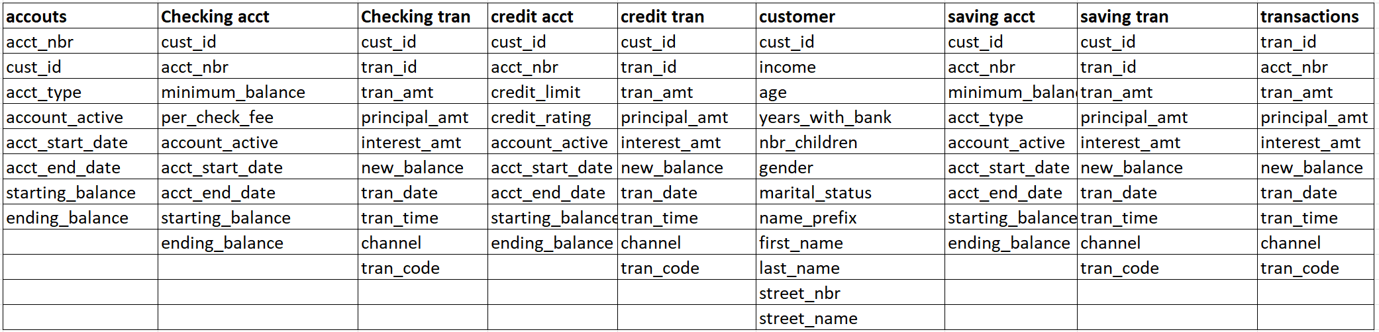
Data Model
Process Flow
Load Data
Data Cleanup
Feature Engineering
Clustering
Centroid
K-Means
PCA
Binning
Log Transformation
Dummy Variables

Slide 4
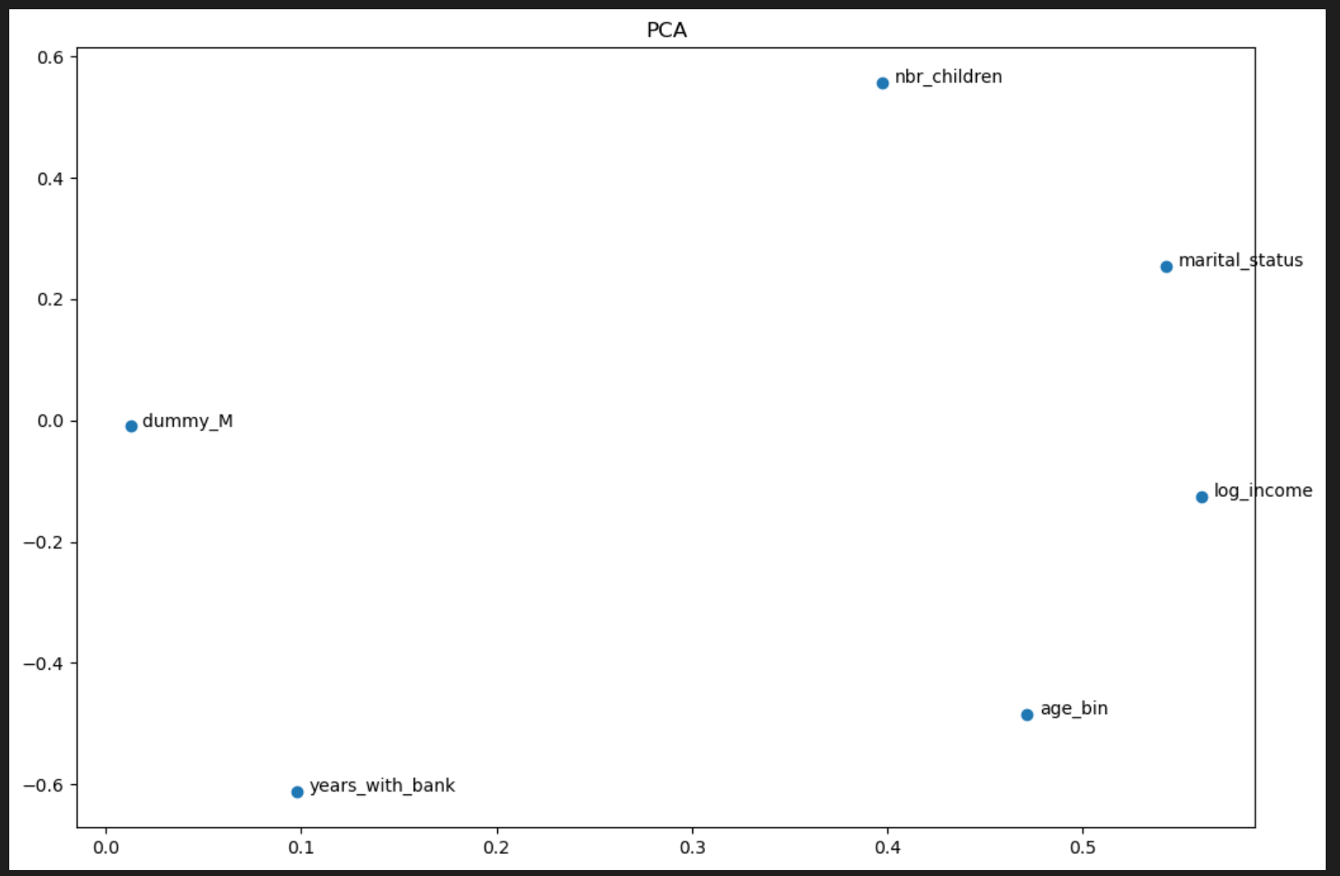
PCA - Demographics

Slide 5
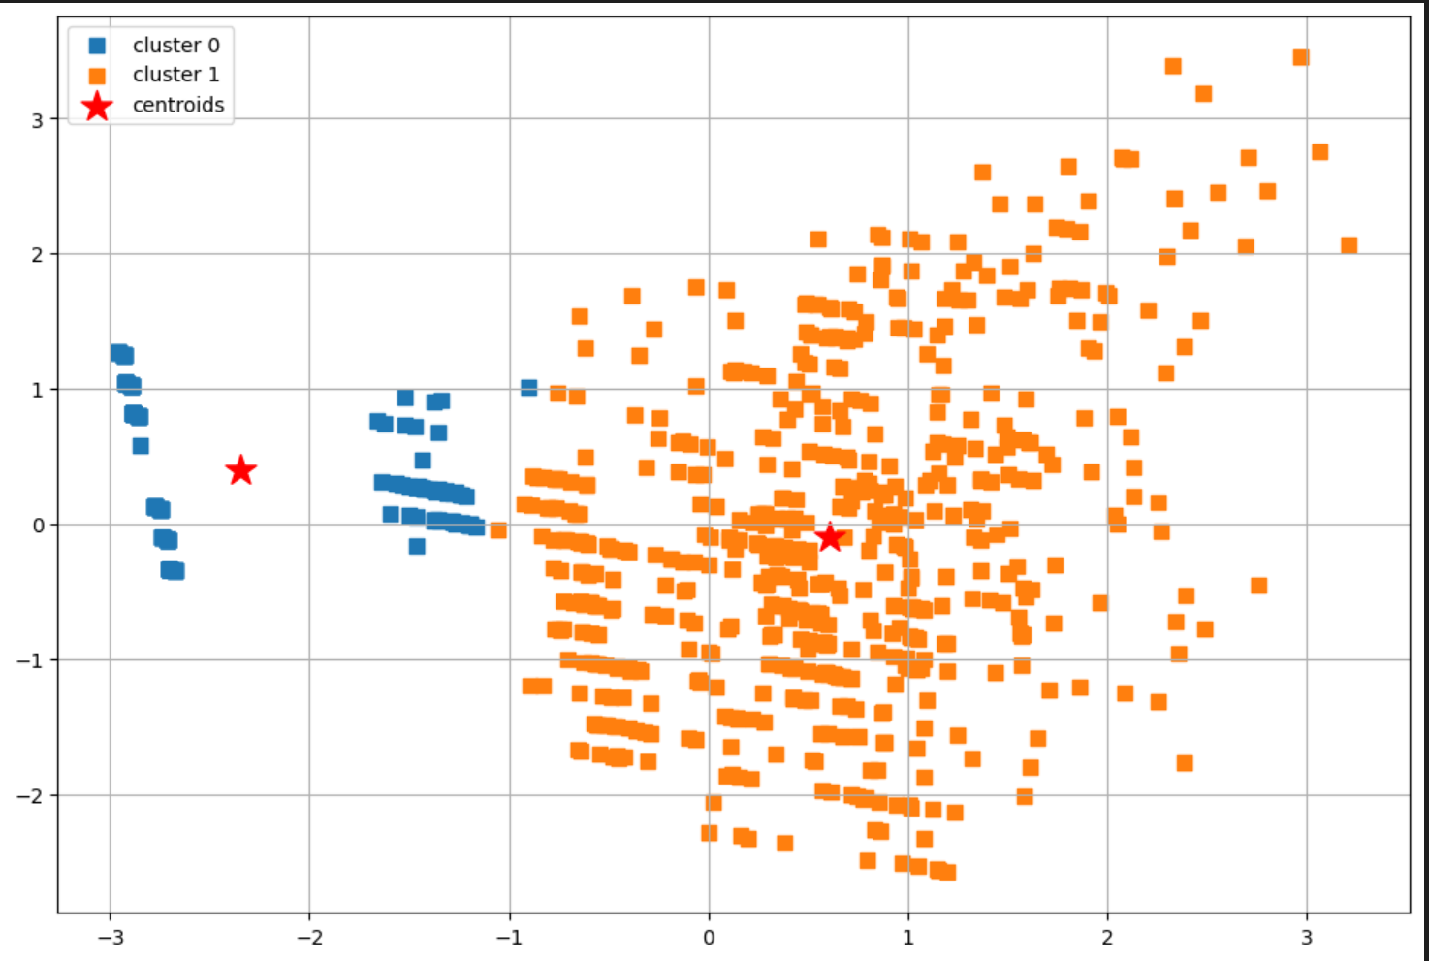
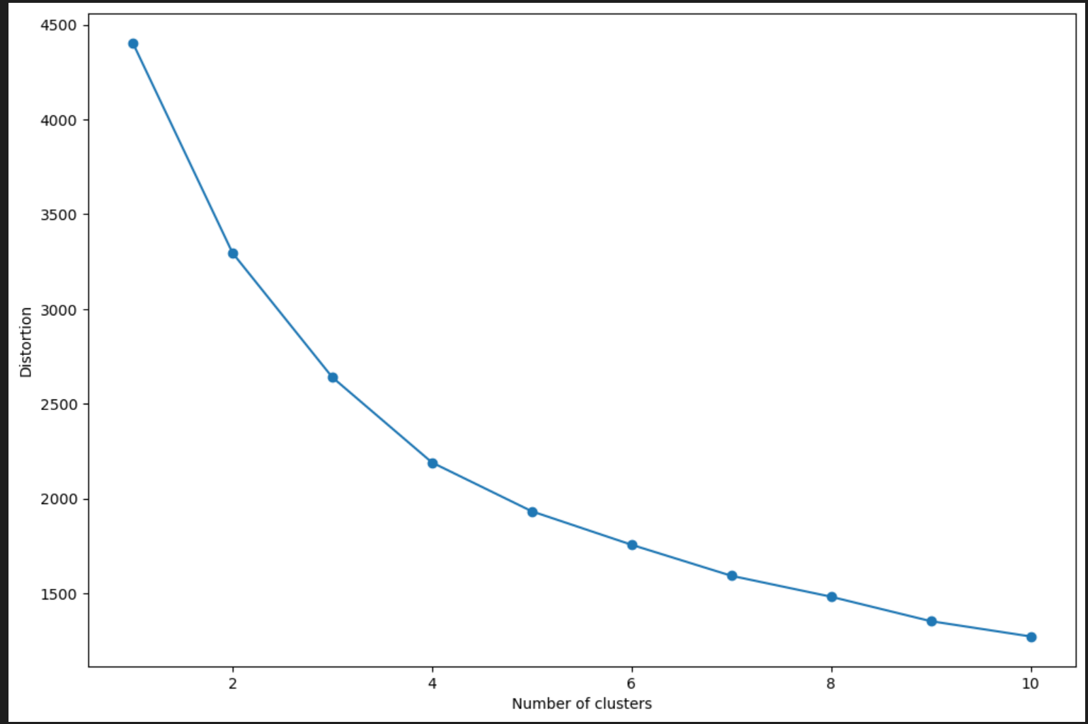
Customer Demographics

Slide 6
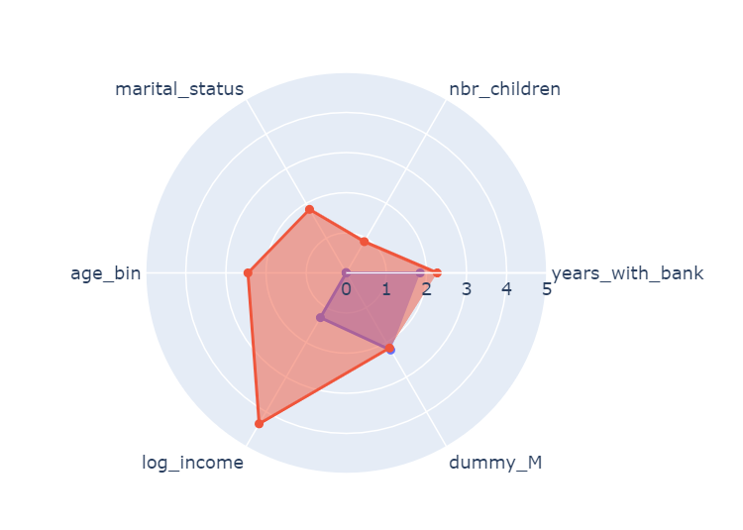
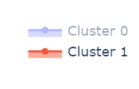
Customer Demographic - Radar chart

Slide 7
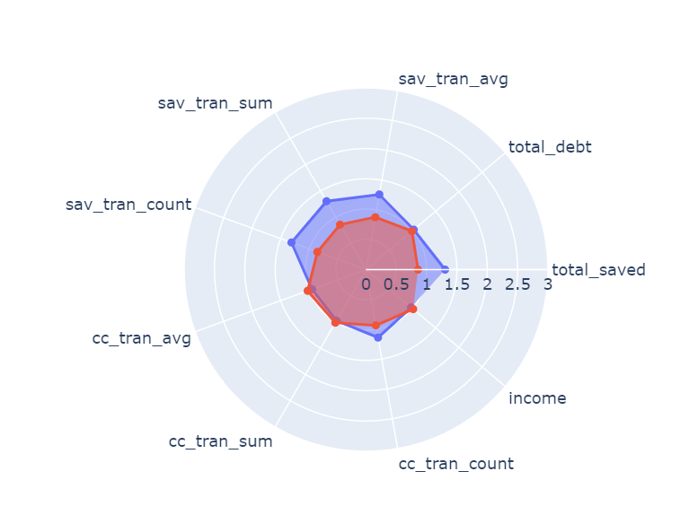
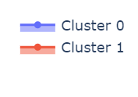
Banking Behavior – Radar Chart

